Slide 1
SAP HANA Adoption of Non-Volatile Memory (VLDB 2017)
Mihnea Andrei, Rolando Blanco, Daniel Booss (SAP SE)
Thomas Willhalm (Intel)
Hushuang
Notes:
Mihnea Andrei: Technical Director at SAP.
Thomas is a software engineer working since 2005 in Intel's Developer Relations Division.

Slide 2
Index
Motivation
Architecture
Challenges
Challenge1-- handling of the pointer values Challenge2--different persistence life cycle Challenge3--guarantee of the data lost
Evaluation
2/21

Slide 3
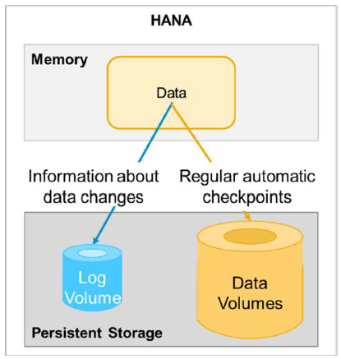
Motivation
The goal of HANA is the integration of transactional and analytical workloads within the same data management system.
When the Delta fragment becomes too large, it is merged into the Main fragment and a new empty Delta is created.
3/21

Slide 4
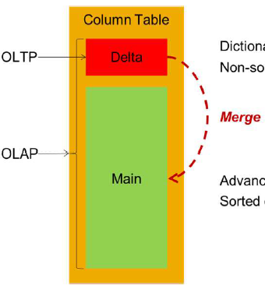
Motivation
Delta fragment: writer-friendly
containing smaller part of the data
non-sorted dictionaries
N-bit compressed(固定位长算法)
Main fragment： reader-friendly
containing most of the data
changing rarely
sorted dictionaries(字典算法),
run length(Run-length encoding),
etc
4/21
Notes:
HANA支持列存也支持行存，可由用户配置，因为列存做过优化，大部分用户使用的时候都选择列存，本文主要讨论列存

Slide 5
Motivation
In-Memory -> providing faster read and write performance.
But…
All DRAM data is lost once the power is turned off.
Being bound by the per-node available memory limit.
Restarting an in-memory DBMS involves reloading the tables/columns and rebuilding the auxiliary data structures.
6/21

Slide 6
Motivation
How an in-memory database like HANA can take advantage of NVRAM while minimizing the negative impact of its drawbacks?
HANA has grown into a mature DBMS
Re-implementing all these features based on NVRAM would have been a huge effort and would have diluted our focus.
We have thus decided to keep the disk-based persistency, and
adopt NVRAM beside it. We have focused on an early adoption,
where HANA consumes NVRAM without heart surgery on the
core relational engine.
7/21

Slide 7
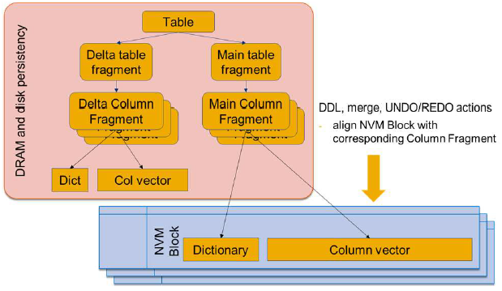
Architecture of HANA-NVM
The early adoption architecture is thus for NVRAM to replace DRAM for the Main Column Fragment Structures.
8/21
Notes:
引入NVM而采用这样的架构的原因是：1.不想大动Hana原有结构与执行流程。2.NVM对读的性能比较好，并且顺序写性能高于其随机写性能，则将其中main数据放在NVM中。这样不会影响原有

Slide 8
Why?
Frequent NVRAM writes need to explicitly keep in-sync (the traditional HANA persistency layer and the NVRAM)
Sequential scans fare better in NVRAM than point reads
The column vector data is sequentially scanned in many cases, more often within analytical workload
Luckily, updates of the Main Column Fragment data are infrequent; actually the only writer is the Delta Merge process.
9/21

Slide 9
Challenges
How to handle NVRAM mixed with DRAM in the DBMS virtual memory address space.
What data structures to place in NVRAM. How to handle their persistent lifecycle.
Extra care will need to be taken to guarantee that filesystem metadata gets flushed.
10/21

Slide 10
Challenge1-- handling of the pointer values
Each time HANA starts, all the memory allocations (including NVRAM blocks) are mapped to different virtual memory addresses. Any pointer persisted in NVRAM therefore will need to be remapped.
During the write of a Column Fragment into NVRAM, only descriptive data and pointers to content data are kept in DRAM,
the pointers are switched from DRAM addresses to the
corresponding addresses within the mapped NVRAM block.
11/21

Slide 11
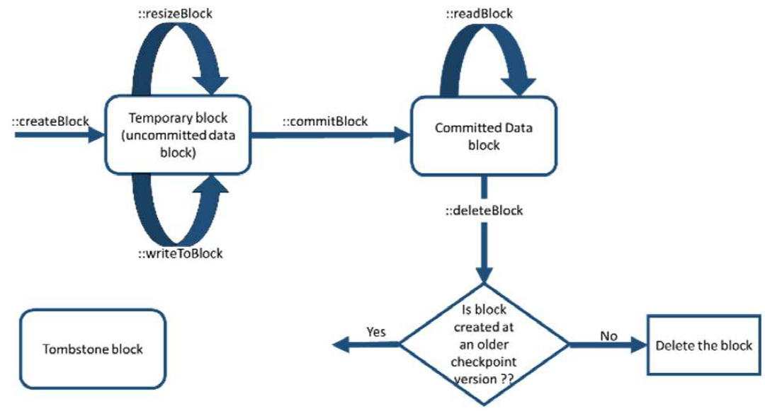
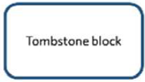
Challenge2--different persistence life cycle
12/21

Slide 12
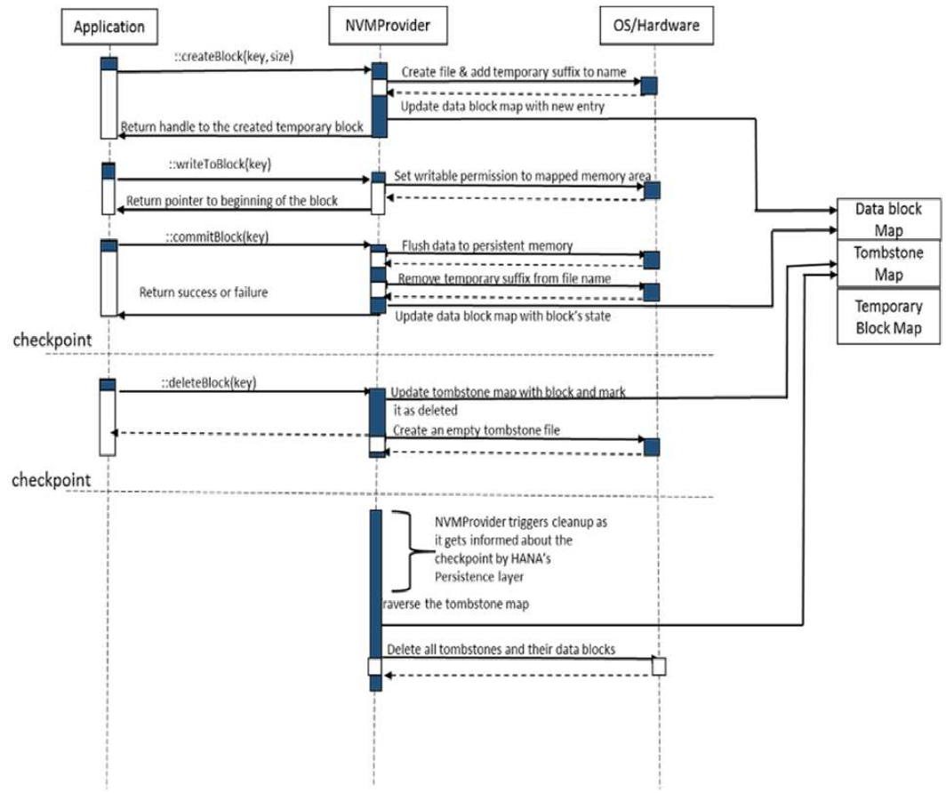
13/21

Slide 13
Challenge3—guarantee of the data lost
The NVRAM technology on Linux will be based on DAX (“Direct Access（直接访问）”). Linux filesystems often create files with holes (storage is physically allocated only at the time of actual writes to the file).
With the DAX-based architecture, NVRAM relies on user-space flushing (using hardware instructions, CLFLUSH) When the store causes a page fault so the file system can fill the hole with a new allocation. The file system metadata
that gets updated by that fault may not be flushed to persistence until msync() is called.
14/21
Notes:
当存储导致页面错误时，文件系统可以用新的分配填充该空间，覆盖原来的内容
刷新变化函数msync()，
可以通过调用msync()函数来实现磁盘文件内容与共享内存区中的内容一致,即同步操作.

Slide 14
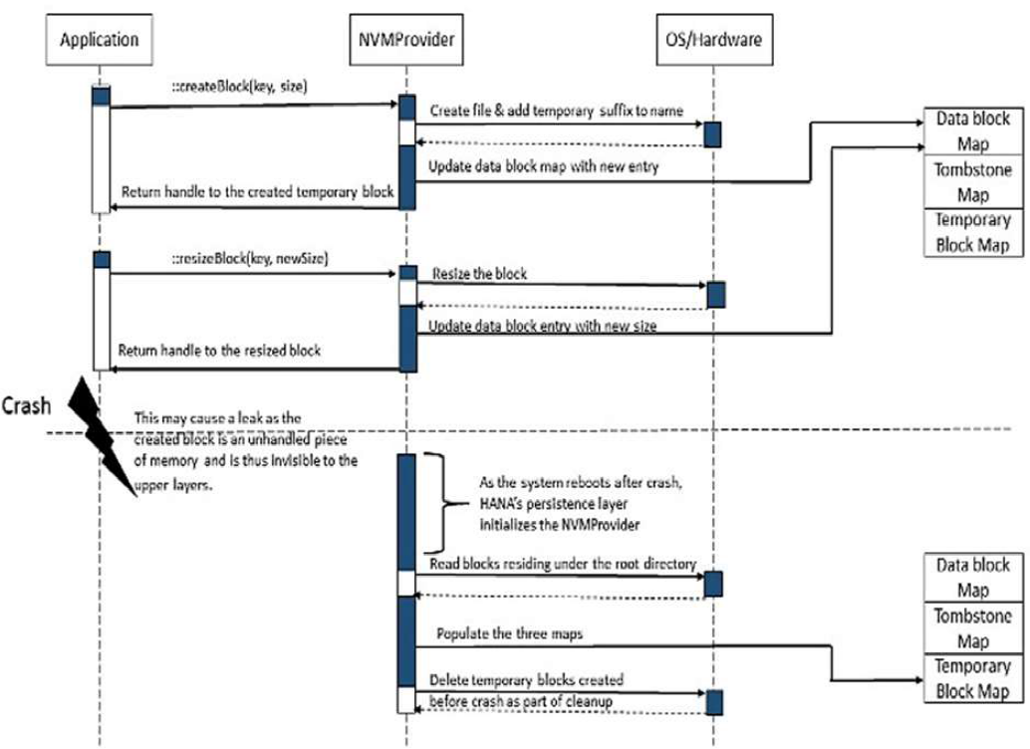
Challenge3
15/21

Slide 15
Evaluation
The system is equipped with 2 Intel Xeon processors E5-4620 v2 with 8 cores each, running at 2.6 GHz without Hyper-Threading（超线程技术）.
Our system was equipped with 256GB of memory, with 128GB configured as PMEM and 128GB as DRAM. This special processor and BIOS has the capability to add memory latency to certain memory regions.
16/21
Notes:
超线程技术就是利用特殊的硬件指令，把一个物理内核模拟成两个逻辑内核，让单个处理器都能使用线程级并行计算，进而兼容多线程操作系统和软件，减少了CPU的闲置时间，提高的CPU的运行速度。
虽然采用超线程技术能同时执行两个线程，但它并不象两个真正的CPU那样，每个CPU都具有独立的资源。当两个线程都同时需要某一个资源时，其中一个要暂时停止，并让出资源，直到这些资源闲置后才能继续。因此超线程的性能并不等于两颗CPU的性能。
BIOS是英文"Basic Input Output System"的缩略语，直译过来后中文名称就是"基本输入输出系统"。其实，它是一组固化到计算机内主板上一个ROM芯片上的程序，它保存着计算机最重要的基本输入输出的程序、系统设置信息、开机后自检程序和系统自启动程序。 其主要功能是为计算机提供最底层的、最直接的硬件设置和控制。
双通道，就是在北桥（又称之为MCH）芯片级里设计两个内存控制器，这两个内存控制器可相互独立工作，每个控制器控制一个内存通道。在这两个内存通过CPU可分别寻址、读取数据，从而使内存的带宽增加一倍，数据存取速度也相应增加一倍（理论上）。

Slide 16
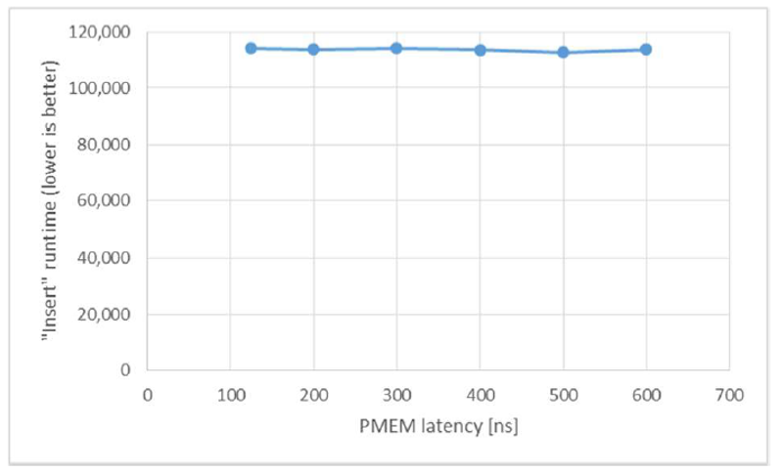
Evaluation
17/21
Notes:
Insert in a table with 4m rows and 500 columns. All data in the table resides in main store,100000insert的时间

Slide 17
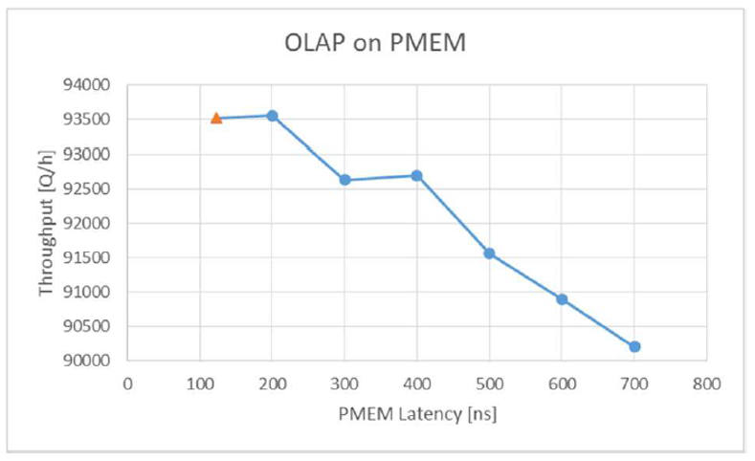
Evaluation
18/21

Slide 18
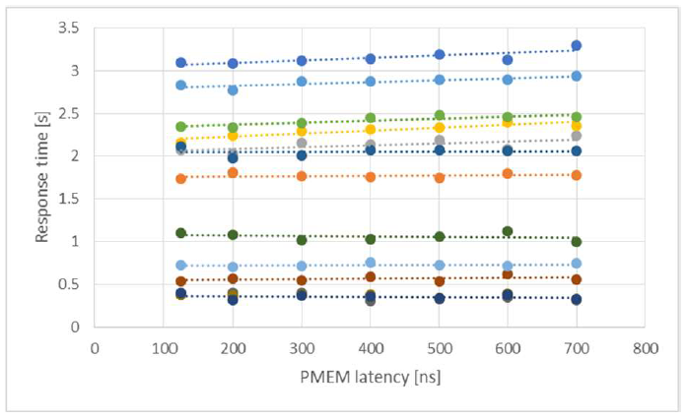
Evaluation
19/21

Slide 19
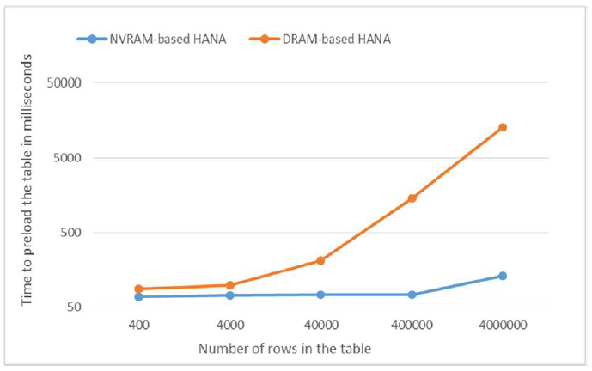
Evaluation
20/21

Slide 20
Conclusion
1.HANA-NVM是内存数据库中引入NVM的早期尝试，指出了其中的三个挑战：DRAM与NVRAM的指针映射，NVRAM数据的管理与宕机恢复的实现，并给出了相应的解决方案。
2.实验验证，HANA-NVM保持了HANA原有的AP与TP的性能，并且宕机恢复的性能在引入NVM之后有了显著提高。
20/21

Slide 21


